Slide 1
Testicle (&leg) Swelling
Matt Cook
Mark Newcomb

Slide 2
Outline
Case Presentation
Discussion
ED Management of the Final Diagnosis

Slide 3
Chief Complaint
64 y.o.
“Testicle Swelling”
HR 89 BP 110/83 T 97.7 RR 18 SpO2 100%
“Testicles swollen & pain for 5 weeks. Recent surgery for inguinal hernia in May” presenting via EMS

Slide 4
HPI
64 y/o with history of hepatitis C, cirrhosis, and hepatocellular carcinoma presents with cc: testicle swelling for 5 weeks. He has also been bothered by painful swelling in both of his legs for approximately the same amount of time. He had a recent left inguinal hernia repair in May 2017.
He presents today because he had no transport to his PCP and he wanted a doctor to evaluate his swollen testicles so he pressed his “life alert” button.
Meds: furosemide, spironolactone, ……..
Allergies: NKDA
ROS: no fevers, nausea, vomiting, chest pain, SOB, changes in stools. Legs and stomach are painful and, “I haven’t peed for real in weeks, my urine just dribbles out now.”
PMH: denies any medical problems at first. Later admits to HCV and HCC, recent inguinal surgery repairs.
Notes:
Add in full med list

Slide 5
Physical Exam
Vital Signs: HR 89 BP 110/83 T 97.7 RR 18 SpO2 100% RA (unchanged)

Slide 6
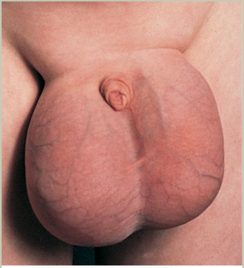
Physical Exam

Slide 7
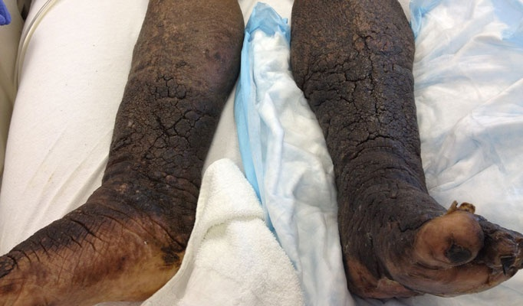
Physical Exam
Notes:
Elephantiasis Nostras Verrucosa – results from lymphatic obstruction or even chronic venous stasis, obesity, CHF, etc.

Slide 8
Physical Exam
Notes:
He also has mild gynecomastia.
Mild generalized discomfort to palpation of the abdomen without rebound or guarding. Moderately distended but soft.

Slide 9
Physical Exam

Slide 11
Torsion
Notes:
Talk about age (two peaks – neonatal and 65% of cases are between 12-18 yrs)
- The acute scrotum. Edelsberg JS, Surh YS Emerg Med Clin North Am. 1988;6(3):521.
Most will have nausea and vomiting
Most will present within 12 hours

Slide 12
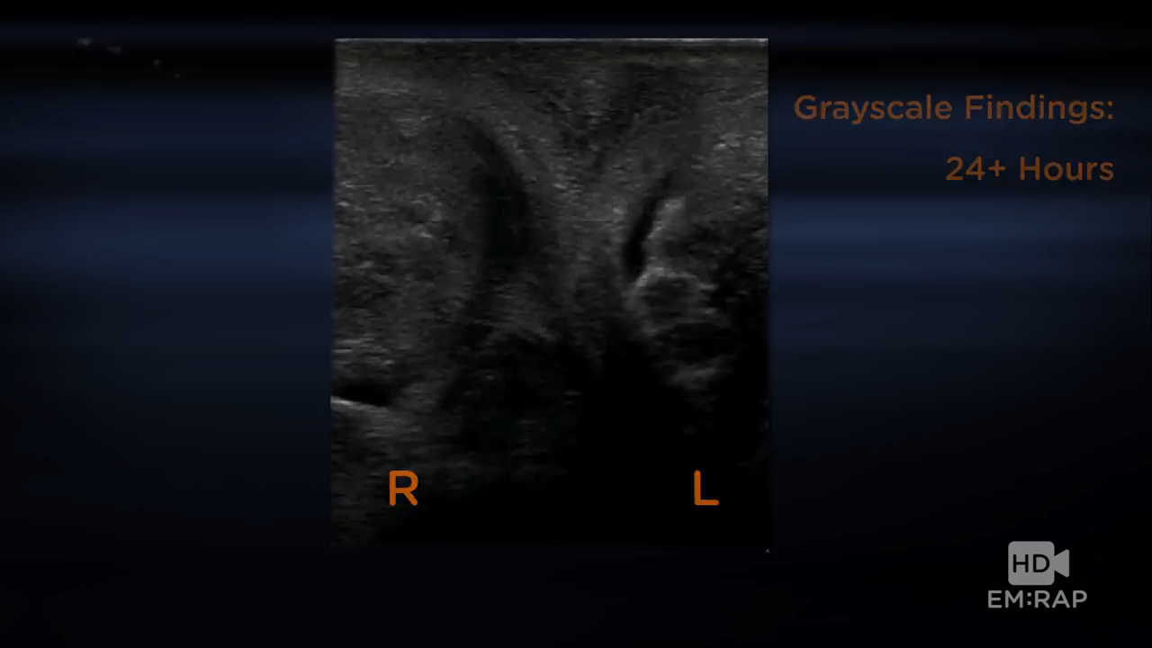
Torsion
Notes:
Don’t forget intermittent torsion – ultrasound is only 75% sensitive, it’s a clinical diagnosis.
Intermittent testicular torsion in the pediatric patient: sonographic indicators of a difficult diagnosis.AUMunden MM, Williams JL, Zhang W, Crowe JE, Munden RF, Cisek LJ SOAJR Am J Roentgenol. 2013;201(4):912.

Slide 13
Nephrotic Syndrome
Notes:
Membranoproliferative glomerular nephritis is assoc with Hep C
Usually more blood than protein (nephritic)
Membranous nephropathy can complicate malignancy
Or amyloidosis
Both would show protein in the urine, which our patient did not have
No specific treatment for renal protein wasting outside of lisinopril – acute management = diuresis and dietary modification, transplant if not reversible.

Slide 14
Right Heart Failure/Pulm HTN
Notes:
Right heart failure shows:
Elevated JVP
Exertional chest pain
Anorexia or RUQ pain d/t passive hepatic congestion
Peripheral edema
BNP can play a role in diagnosis – our pt’s was 190 which is nondiagnostic and was in line with prior labs
- Can perform an echocardiogram to look for signs of right strain – this was deferred until the floor d/t having a good reason for ascites and pt’s stable vitals. He was on a drug for hep c known to cause cardiomyopathy, though.

Slide 15
Indirect Inguinal Hernia
Notes:
Patients with cirrhosis and ascites have an increased rate of inguinal hernias
Recurrence rates at 30 months are between 2.5%-4.5%. About 2/3 of the recurrence happens in first 15 months
Quality assessment of 26,304 herniorrhaphies in Denmark: a prospective nationwide study. Bay-Nielsen M, Kehlet H, Strand L, Malmstrøm J, Andersen FH, Wara P, Juul P, Callesen T,
Danish Hernia Database Collaboration. Lancet. 2001;358(9288):1124.
Symptoms include nausea, vomiting, abdominal pain and bloating, +/- systemic symptoms if necrosis has occurred. Scrotum may be erythematous and pt +/- fever.

Slide 16
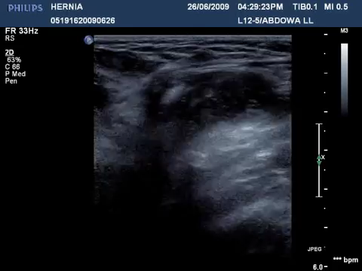
Indirect Inguinal Hernia
Notes:
Look for peristalsing bowel
- Signs of incarceration on ultrasound: free fluid in the hernia sac, bowel wall thickness > 4mm, free fluid within bowel loops, absence of blood flow within hernia

Slide 17
Budd-Chiari Syndrome
Notes:
Malignancy (hepatocellular carcinoma is most common), lesions of the liver, and hypercoagulable states (Factor V leiden, Protein C/S deficiency, antiphospholipid ab syndrome), Behcet disease
Symptoms include lower peripheral edema, scrotal edema, normal JVP, normal heart exam, large abdominal veins.
Can evaluate for BC with an ultrasound (our case was at night and we had other things to evaluate) or cross-sectional imaging

Slide 18
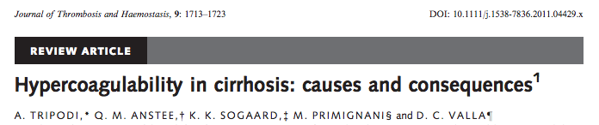
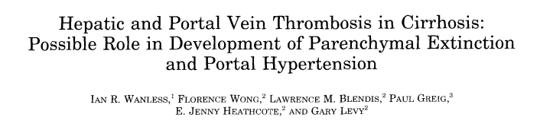
Budd-Chiari Syndrome
Notes:
70% of 61 cirrhotic livers removed at transplantation showed evidence of hepatic vein thrombosis
Wanless IR, Wong F, Blendis LM, Greig P, Heathcote EJ, Levy G. Hepatic and portal vein thrombosis in cirrhosis: possible role in development of parenchymal extinction and portal hypertension.
For these patients with cirrhosis and budd chiari, you would likely be starting them on anticoagulation, even with liver failure.

Slide 19
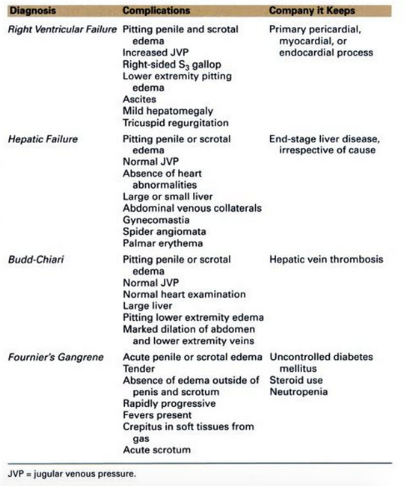
Budd-Chiari Syndrome
Notes:
fever, abdominal pain, abdominal distension (from ascites), lower extremity edema, jaundice, gastrointestinal bleeding (from varices or portal hypertensive gastropathy), and/or hepatic encephalopathy
Ascites has high SAAG (>1.1) due to high hydrostatic pressure
In acute budd-chiari:
Develops over weeks
RUQ pain, hepatomegaly, +/- jaundice
Variably elevated AST/ALT, alk phos, and bilirubin
Subacute/chronic budd-chiari:
Develops over months, due to large hepatic collaterals
May be asymptomatic or have ascites + LE edema
LFTs may be normal or only slightly elevated
Hepatomegaly and abdominal pain, but no encephalopathy

Slide 20
Work-up
Notes:
Labs:
BNP-190
CBC/BMP
Unable to obtain UA
Lactate 3.5
LFTs – showing albumin of <1.5, AST of 51, total bilirubin 3.6
Coags – inr 2.3
Calcium 7.7 – but corrected it’s 9.7
CT Abd/Pelvis with contrast – eval for incarcerated bowel, hepatic venous thrombosis, evidence of malignancy/mets
Admitted for diuresis, discharged 9lbs down

Slide 21
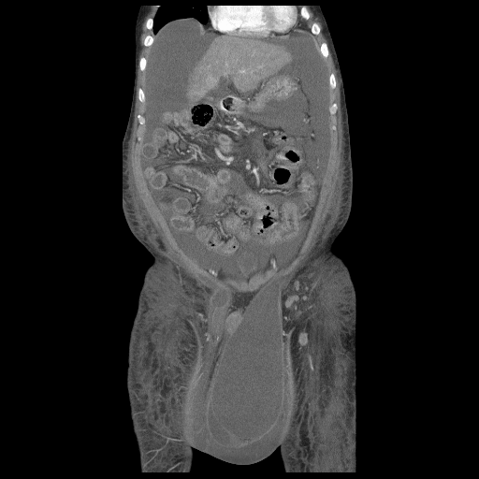
Work-up
Notes:
Labs:
BNP-190
CBC/BMP
Unable to obtain UA
Lactate 3.5
LFTs – showing albumin of <1.5, AST of 51, total bilirubin 3.6
Coags – inr 2.3
Calcium 7.7 – but corrected it’s 9.7
CT Abd/Pelvis with contrast – eval for incarcerated bowel, hepatic venous thrombosis, evidence of malignancy/mets
Admitted for diuresis, discharged 9lbs down

Slide 22
Brief pathophysiology of varices
Management of acute variceal bleeds
Initial interventions
Treating portal HTN
What if they like, just don’t stop bleeding?

Slide 23
64 y/o with history of hepatitis C, cirrhosis, and hepatocellular carcinoma presents with cc: testicle swelling for 5 weeks. He has also been bothered by painful swelling in both of his legs for approximately the same amount of time. He had a recent left inguinal hernia repair in May 2017.
…
Nurse says “your patient just vomited up blood…. A lot of blood”
You see the patient and there is a lot of BRB, begin initial assessment.

Slide 24
What could be going on?
Upper GI bleed
MCC upper GI bleeding in adults?
Duodenal ulcers → gastric ulcers → gastritis → esophageal varices → esophagitis
Peptic ulcers – up to half
Mortality – half of those that die from a GI bleed have either varices or a peptic ulcer
Active variceal bleeding accounts for about 1/3 of all deaths related to cirrhosis

Slide 25
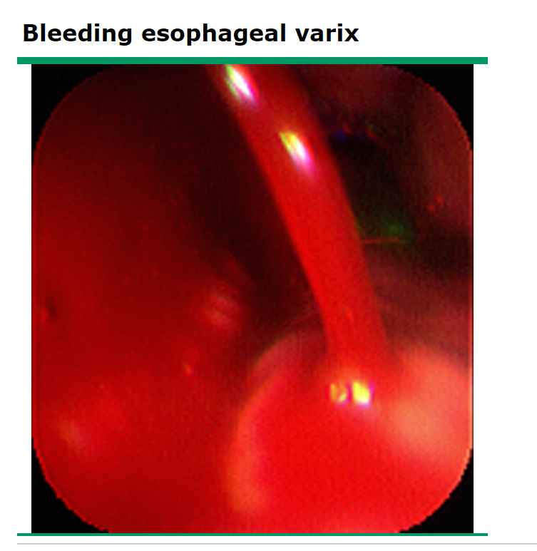
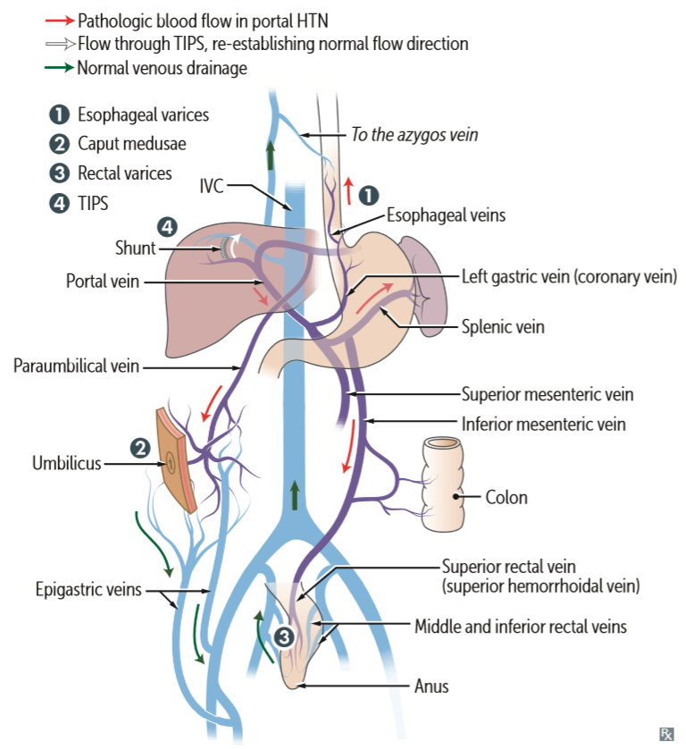
Variceal Bleeding
Cirrhosis → Portal hypertension
Release of vasodilatory factors (NO)
Splanchnic vasodilation
Increased diameter of pre-existing blood vessels → varices
Only 50% of people with an acute bleed will stop bleeding on their own

Slide 26
Management of Acute variceal hemorrhage
1st Consideration?
Notes:
Early intubation with massive GI bleed has several advantages:
1. It helps you diagnose the source of bleed (i.e.: GI source vs. other)
2. Helps prevent aspiration (hematemesis = high risk for aspiration)
3. Gives you control of the critically ill patient and allows you to monitor bleeding (via
NG tube)
Remember to pre-oxygenate these patients, as they will have little O2
reserve. You want to limit the amount of bag valve mask ventilation
required, as this leads to abdominal distention, which increases the risk of
aspiration, and preoxygenation helps limit BVM use.
● RSI: choose a hemodynamically stable drug (i.e.: Swadron prefers etomidate;
Miz likes ketamine).

Slide 27
Airway
Do I need to intubate this person?
Factors to consider
Is bleeding severe?
Patient agitated? Or intoxicated?
Advantages to tubing them
Prevent Aspiration
Now you (yes you) can place an NG tube
Great if you anticipate scope
Key Points when intubating these people
Pre-ox → why?
Bag → abdominal distention → Increased aspiration risk

Slide 28
Breathing
Via ET tube

Slide 29
Circulation
How massive is this bleed?
Patients may be bradycardic… why?
Often prophylaxis with beta blockers
Intraabdominal hemorrhage → vagal response
Resuscitate them
Blood ASAP
Don’t forget to add plasma and platelets (people with bad livers need these)
Additional efforts
IV vitamin K
Platelets

Slide 30
Done…. Right?
You have now resuscitated the patient to the point that you feel they have adequate perfusion
What further steps do we need to take?

Slide 31
Acute treatment of Variceal Bleeding
Octreotide
Reduction in splanchnic blood flow
Only parenteral
Antibiotics
Prevention of SBP
Beta Blockers
Non-selective (propranolol, nadalol)
B1 – reduce CO (do we really want to do this?)
B2 – splanchnic vasoconstriction

Slide 32
Octreotide
Long acting somatostatin analogue
Acts by constricting splanchnic blood vessels → decreased splanchnic blood flow
As a group vasoactive medications:
Improved hemostasis
Decrease in 7 day mortality
Decrease transfusion requirements

Slide 33
Which Antibiotics to Use?
American Association for the Study of Liver disease:
If patient has advanced cirrhosis
Ceftriaxone 1g/day
Any patient with cirrhosis and GI hemorrhage should get:
Norfloxacin
Cipro
Alternative: Bactrim

Slide 34
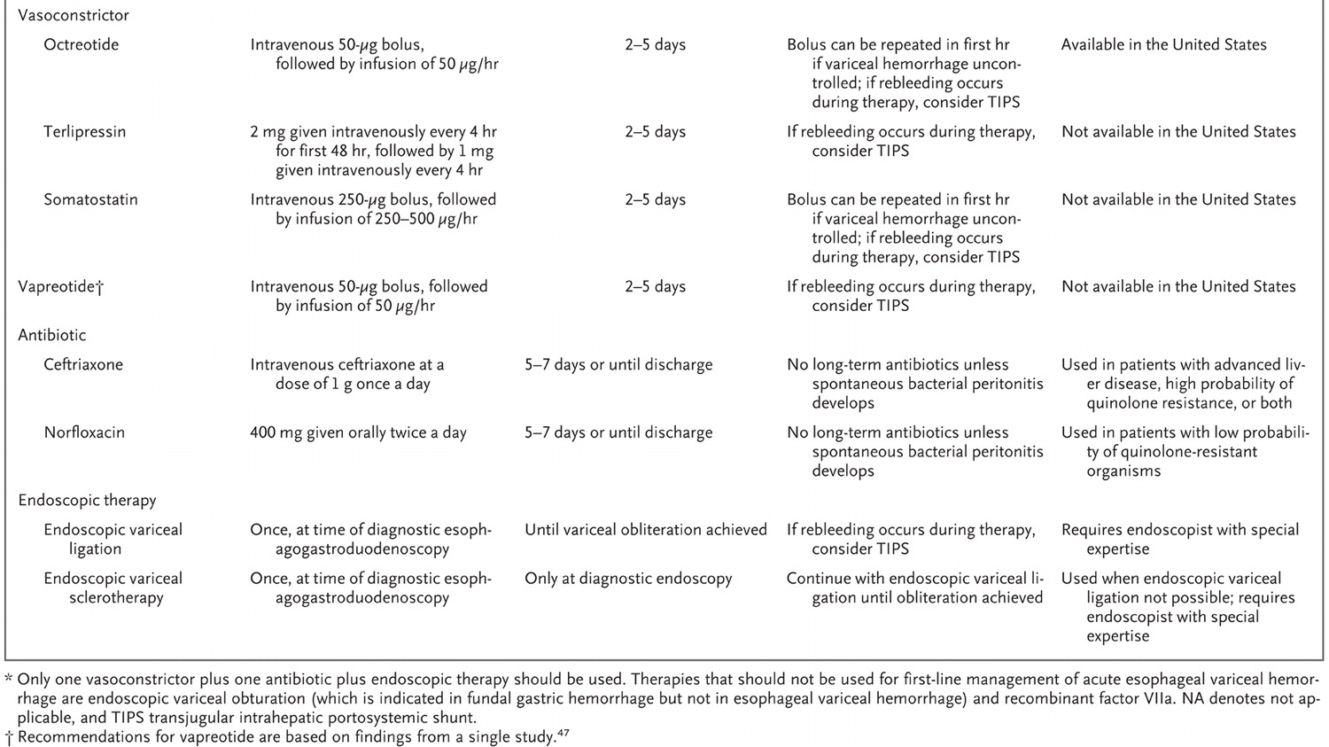

Slide 35
So but like what if they like don’t stop bleeding
Yell at them
Minnesota and Blakemore tubes

Slide 36
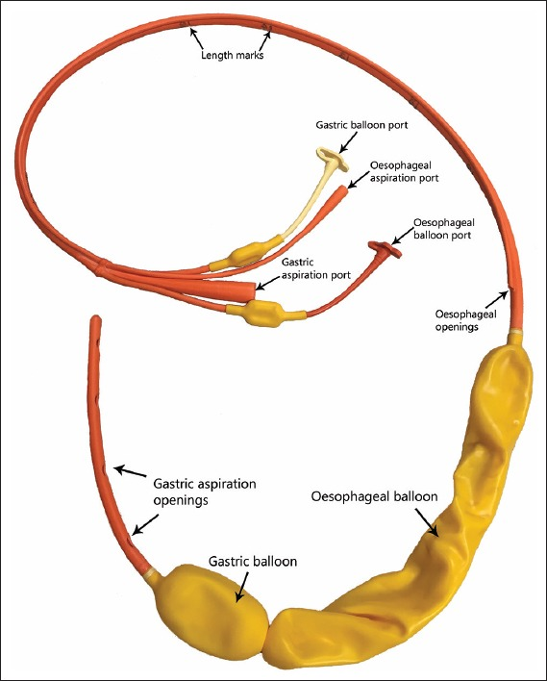

Slide 37
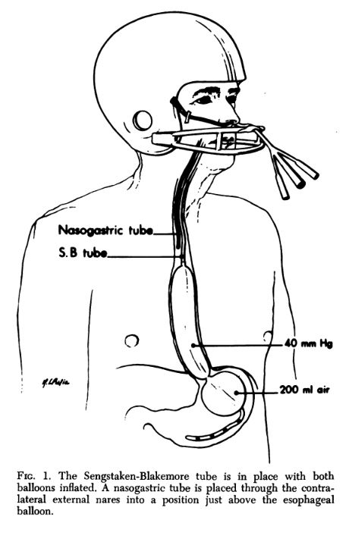

Slide 38
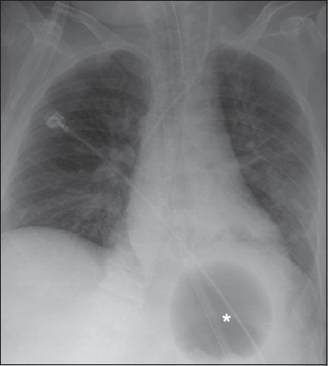

Slide 39
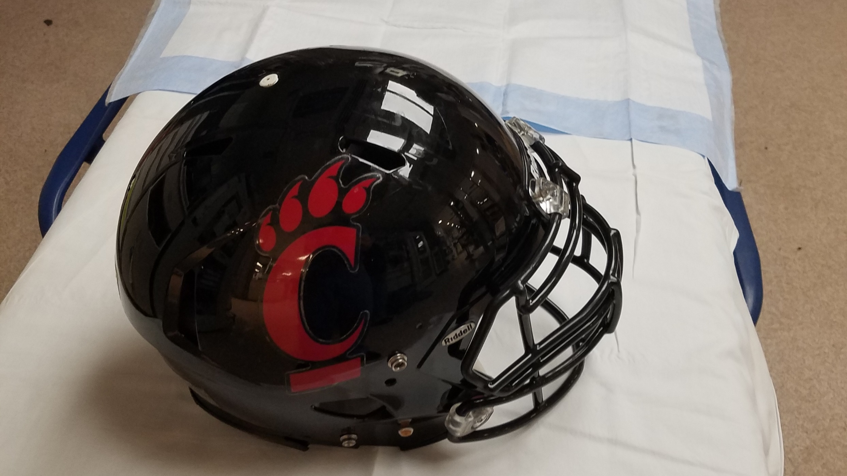
Go Mizzou

Slide 40
Minnesota tube pearls
Don’t leave the big tube in the esophagus
Confirm with X-ray
Have scissors ready to deflate tube if you need
You can sometimes use contrast dye to fill tube and make it more easy to see on x-ray

Slide 41
Definitive management
Endoscopy
TIPS
Angiography
Surgery

Slide 42
Questions?

